Slide 1
Gen AI Orchestrator for Email and Document Triage/Routing
Team: Starwalkers
Members:
Saumya Sharma
Immaculate Maria Fernando

Slide 2
🚀Problem Statement
There is a significant volume of servicing requests through emails. These emails contain diverse requests, often with attachments and will be ingested to servicing platforms and creates service requests which will go through the workflow processing.
Incoming service requests (SR) via e-mail require a manual triage, where a "Gatekeeper" who:
Reads and interprets the emails content and attachments.
Identify the intent of the email and classify the "Request Type and "Sub Request Type".
Extract key attributes for populating in service requests.
Assigns the request to the appropriate team or individual based on roles and skills.
This manual triage process requires a team of gate keeps and time consuming Sometimes it's inefficient and error prone when volume is large,

Slide 3
🎯Our Solution
We developed a solution to streamline email classification within a banking or finance context. Our project focuses on automating the categorization of incoming messages based on specific types (e.g., Money Movement, Fee Payment, Commitment Change), ultimately tackling the complexity of manually handling large volumes of operational emails. By using powerful language models, we aim to reduce human error, save time, and create a more efficient workflow for financial teams.

Slide 4
💡 Inspiration
Our motivation stemmed from observing how front-office and operations teams grapple with ever-increasing email traffic—ranging from routine fee notifications to intricate loan amendments. Recognizing that these requests often require consistent, rule-based decisions, we saw a need for a robust, data-driven approach that could identify context, categorize emails, and serve recommended actions. We took inspiration from enterprise-scale problems like loan syndication and capital markets where even a single classification mistake can have costly repercussions.

Slide 5
⚙️ What It Does
Automated Classification: The system reads and interprets .msg files, extracting both subject and body to determine the appropriate request type.
Bulk Processing: It supports both single-email uploads and batch operations for entire directories, significantly cutting down on manual sorting overhead.
Generative AI Integration: Leveraging state-of-the-art AI models (via Google GenAI), our tool refines its categorization by analyzing linguistic cues and domain-specific keywords.
Exportable and Searchable Insights: Results are stored in structured formats (CSV), facilitating further analytics and reporting.

Slide 6
🛠️ How We Built It
Python & Streamlit: We chose Streamlit for rapid UI development and a clean user experience. Python’s simplicity allows us to integrate multiple libraries without sacrificing readability.
Extract_msg: This library handled Outlook .msg parsing, ensuring our solution can read metadata (subject, body, attachments) in detail.
Google GenAI: We used the google.genai client for classification tasks, providing robust language understanding. Its advanced NLP capabilities help us dissect complex email texts.
AsyncIO & Concurrency: To address potential threading or event-loop conflicts, we incorporated asyncio logic, ensuring stable concurrent calls to the AI APIs.

Slide 7
🚧 Challenges We Faced
1. Event Loop Conflicts: Integrating Google GenAI with Streamlit’s synchronous environment required careful handling of asyncio. We overcame runtime errors by initializing custom loops where necessary.
2. Data Extraction Nuances: Extracting meaningful text from .msg files (especially those with HTML bodies, special characters, or attachments) proved more complex than expected, mandating thorough testing.
3. Scalability: Handling batch classification across thousands of messages in one go required us to optimize I/O operations and ensure the AI calls remained efficient.
4. Domain Terminology: Banking and loan-related emails often contain intricate jargon—our system had to be carefully fine-tuned to recognize subtle differences (e.g., distinguishing “Reallocation Fees” from “Amendment Fees”).

Slide 8
🏗️ Tech Stack
- 🔹 Frontend: Streamlit
- 🔹 Backend: Python
- 🔹 LLM : Gemini 2

Slide 9
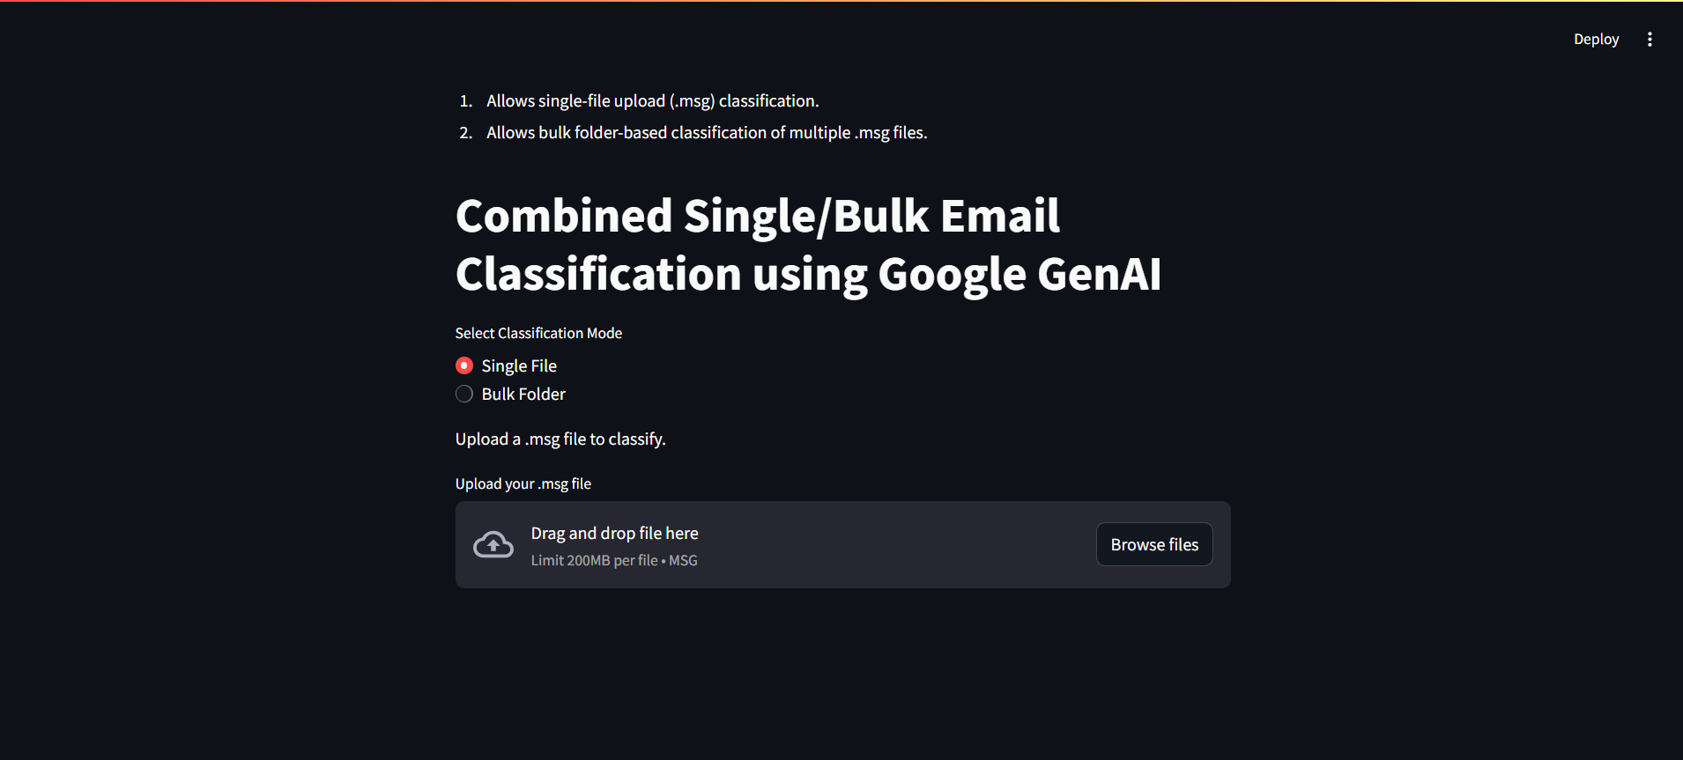
🖼️Solution Screenshot
- 🔹 Frontend: Streamlit
- 🔹 Backend: Python
- 🔹 LLM : Gemini 2

